Slide 1
Hierarchical Video Patching with Optimal Server Bandwidth
Junpeng Qiu
jqiu6

Slide 2
Outline
Video on Demand
Related Solutions
Hierarchical Patch
Simulation & Performance
Pros & cons
Comments to improve the paper

Slide 3
Video on Demand (VoD)
Serve multiple video requests simultaneously while minimizing:
Client bandwidth: # of concurrent retrieval channels in client side
Client buffer requirement: client cache to store the video data
Start-up delay: time from issuing to responding the request

Slide 4
Related solutions
Batching:
Time interval: h
Clients request arriving between h(i-1) to hi are served in hi
Smaller h: higher server bandwidth
Higher h: higher waiting time of the clients
Only near VoD delievered

Slide 5

Related solutions
Patching (non-hierarchical)
L: video length; $λ$: client arrival rate
Time when the i-th request for such video issues: t_{i}
Regular channel: created for first client requesting such video
Patch channel:
Created for client requests at within L after the first client request: $t_{i} < t_{1}+L, i>1$
Exist long enough to serve video from start to t_{i}
Clients play video from patch channels while caching video after t_{i} from regular patch
Theoretical limit of server bandwidth:
$$B=\sqrt{2Lλ+1}−1$$

Slide 6
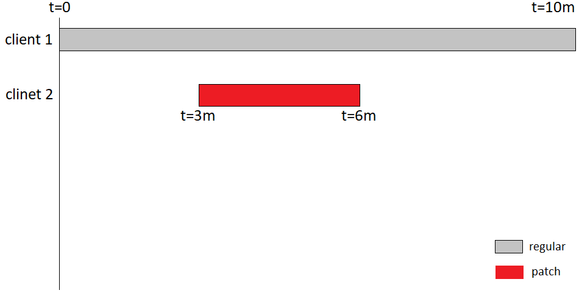
Related Solution
Patching (non-hierarchical) example:
Client 2 joins at t=3m
At t=6m:
client 2 plays first 3m of the video from patch channel
Cached video between 3m and 6m from the regular channel

Slide 7
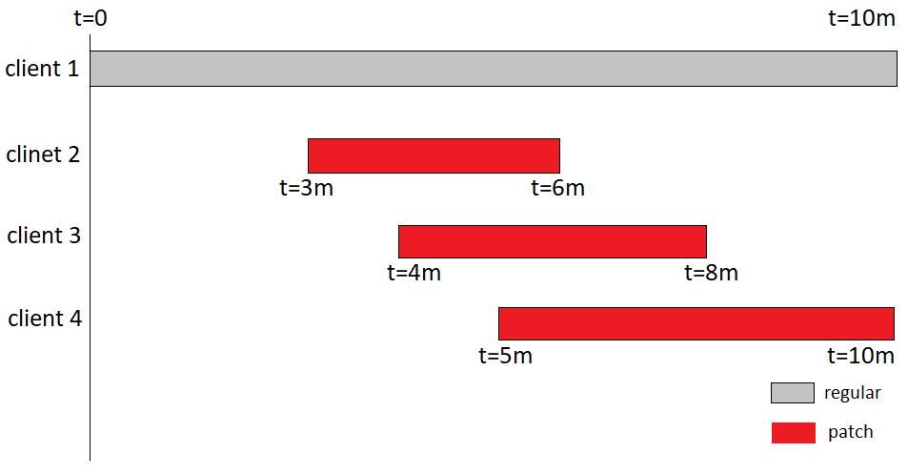
Related Solution
Patching (non-hierarchical) example:
Similarly, client 3 and 4 joins at t=4m and t=5m.
Each creates a patch channels lasting for 4m and 5m respectively

Slide 8

Related Solution
Existing hierarchical patch methods:
Double Patching:
Patching exits in 2 levels, the second level depicts the time window
clients arriving within the same time window share the patch
Fragmented Patching:
$λ$: Client arrival rate
Video divided by $λL$ segments
Regular transmission of each segment always exists
Generally not reaching theoretical limit of bandwidth

Slide 9

Hierarchical Patch
Clients concurrently retrieve video from already existed/schedule patch channels
Patches only created for missing parts of the video
More bandwidth on client sides as client downloads from more channels concurrently
Bandwidth on server sides:
$$B=ln⁡(λL+1)$$

Slide 10
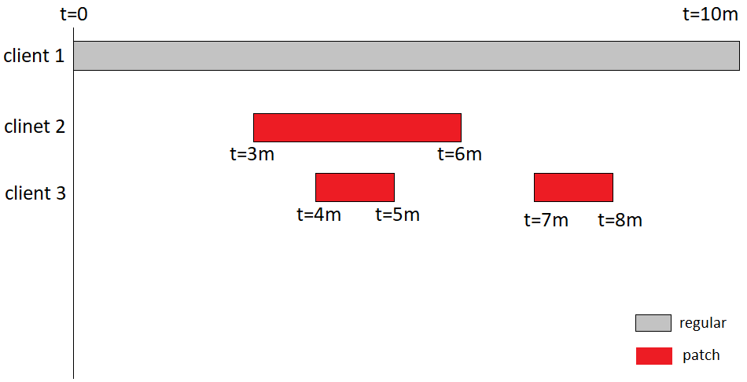
Hierarchical Patch (example)
[a,b): video segment starting from time of a to b
Instead of creating a 4-minute-long patch:
Client 3 reads data from both regular and patch channel of client 2
From client 2 patch: [1m,3m)
From regular: [4m,10m)
Only need patches for [0,1m) and [3m,4m)

Slide 11
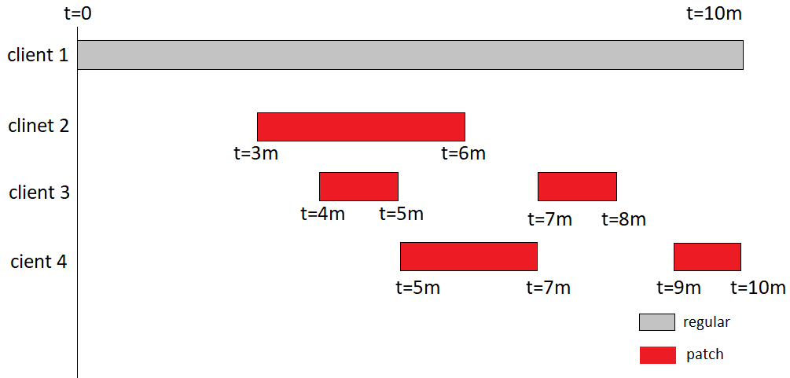
Hierarchical Patch (example)
[a,b): video segment starting from time of a to b
Instead of creating a 5-minute-long patch:
Client 4 reads data from both regular and patch channel of client 2/3
From client 2 patch: [2m,3m), from client 3 patch: [3m,4m)
From regular: [5m,10m)
Only need patches for [0,2m) and [4m,5m)

Slide 12
Simulation
Run for 10000L virtual seconds
Assumption
Scope limited to clients requesting a same video
Servers and clients always have enough channels to deliver/retrieve the video
Clients arrive according to Poisson process (truly random)

Slide 13

Performance
Bandwidth: $B=ln⁡(λL+1)$
Equation v.s. simulation and other models:

Slide 14

Performance
$f_{s}$: % video already transferred and/or scheduled for a new $c_{i}$
$f_{d}$: % video need to be scheduled for a new $c_{i}$
$f_{s}=1−f_{d}$
For model that saves bandwidth by sharing previous created patches:
$f_{s}=1−\frac{B}{λL}$

Slide 15
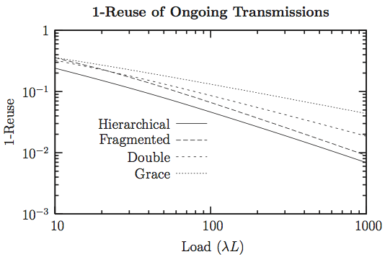
Performance
% video needed to be scheduled for newly arriving clients:
Hierarchical has most reuse rate

Slide 16

Performance
Active patches: patches currently ongoing transmission
Scheduled patches: patches not ongoing but set for future transmission
$α$: minimum % of L served by the patch

Slide 17
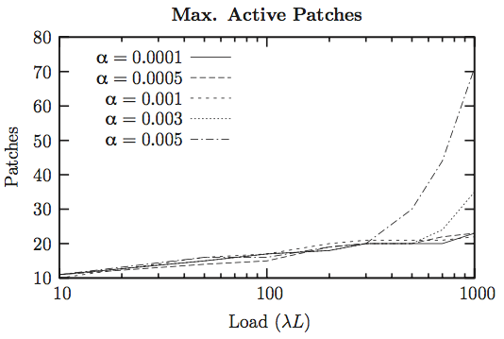
Performance
Toggling $α$:
Higher a yields higher amount of active patches

Slide 18

Performance
Number of inactive patches dominates
Limit on size of patches: # scheduled patches decreases at high load
Combining with previous figure: optimal $α$ is 0.001
Notes:
Keep both numbers of patches in reasonable bounds

Slide 19
Performance
Clients need to concurrently receive data from different patches
1 – ECFD: max % clients using respective # of channels
ECFD: min % clients using < respective # of channels
99% clients using <= 6 concurrently
Upper limit of channels a client need is 23
Clients side can usually handle the network requirement

Slide 20
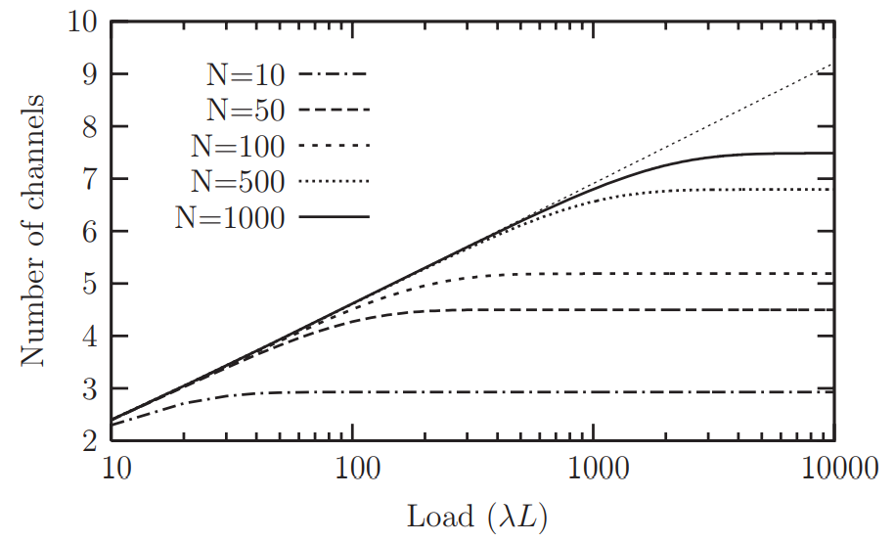
Performance
Batched version of Hierarchical Patching System (near VoD)
Avg # Server Channels and Harmonic series (straight line):
More segments => More load to reach Harmonic function (H(N))
Two cases to study maximum # channels on server:
infinite load: new clients arrive in each time slot
finite load: not every time slot gets new clients

Slide 21
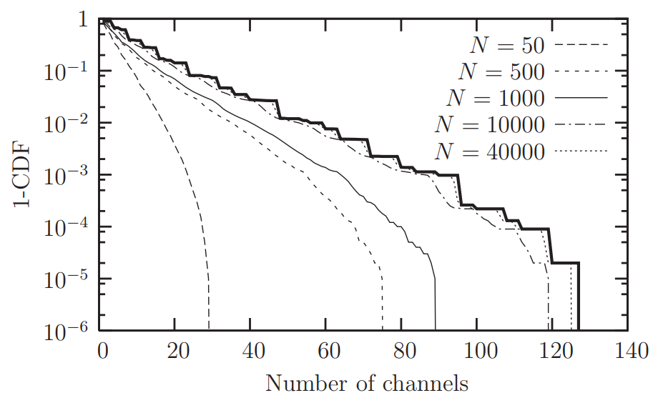
Performance
1-CDF: max # servers serving that # of channels concurrently
Fat line: upper limit # concurrent channels
N >= 1000: > 5.8% servers use more than 22 channels
Infinite: Batched HP provides lowest avg bandwidth while bursts happen

Slide 22
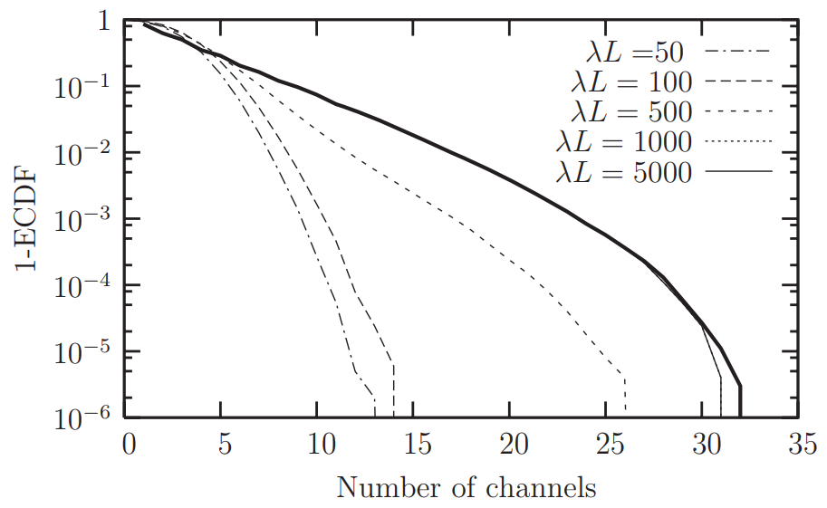
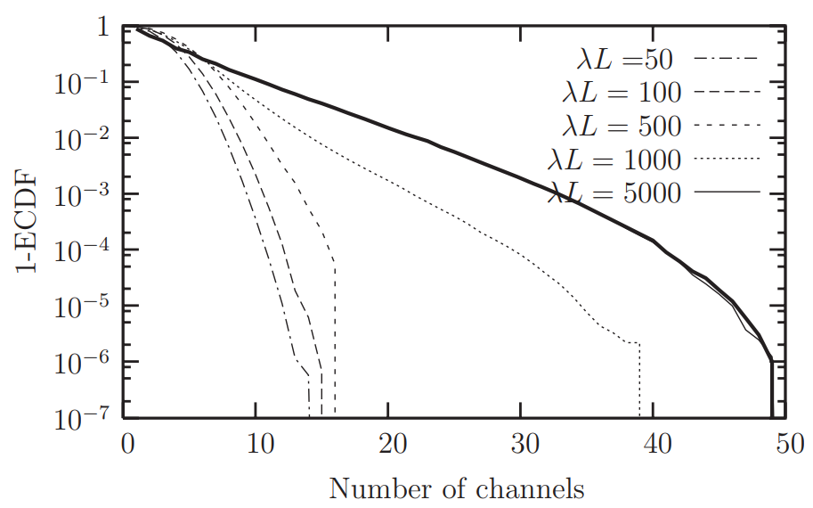
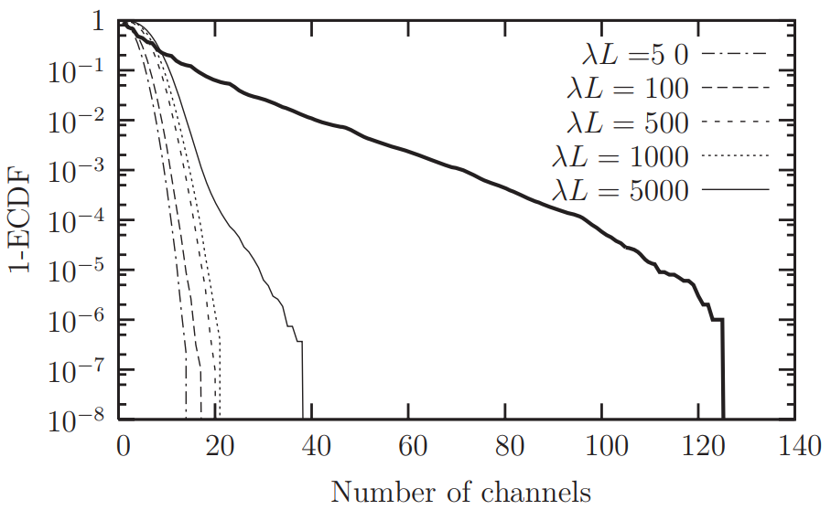
Performance
Finite cases
% Servers using corr # of channles (fat lines: result from infinite cases)
N=50
N=100
N=1000
N=1000: high loads behave most differently from indefinite load

Slide 23
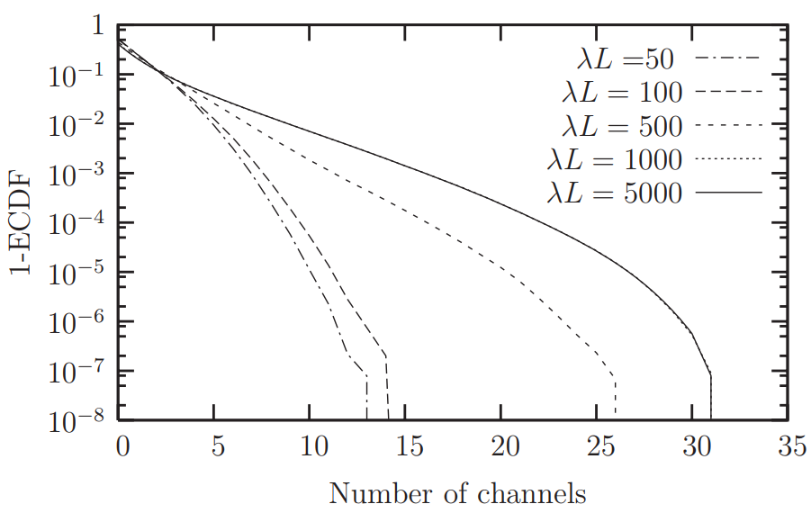
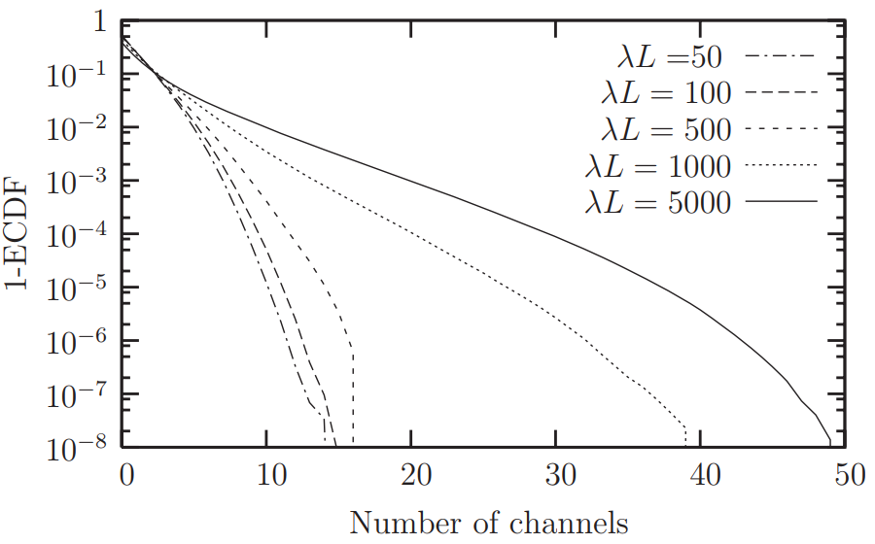
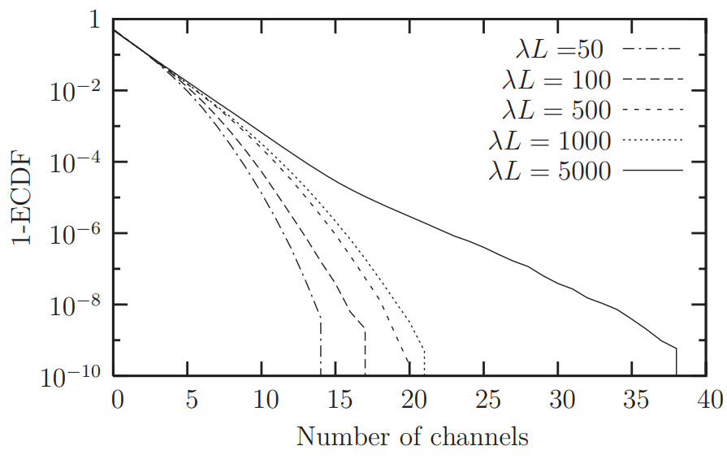

Performance
% client download concurrently from such # of channels:
N=50
N=100
N=1000
N=1000 and $λL<1000$ give least avg waiting time and less # of concurrent channels
Batched HP good at handling high but limited work load

Slide 24
Pros & Cons
Pros:
Intuitive illustration on how hierarchical patch works in a specific example
Rely on simulation result to convince readers of effectiveness
Clear benchmark: # channels concurrently used on server/client
Cons:
No supporting evidence for argument that capability of transferring >= 22 HD video channels (bit rate=1.5mB/s) in the future 10 years
Unrealistic assumption not explicit: each client req video from start to end
Lack of # client channels in infinite Batched case

Slide 25
Comments
New simulation based on: client requests different parts of the video and terminates stream randomly
Improve the method by enabling transmission across clients:
Clients do not delete video from cache immediately
Clients send video to others from cache

Slide 26

Conclusions
Hierarchical patches decrease avg bandwidth for servers
choices of parameters exist to limit the bandwidth on client <=22
$α=0.001$: near-optimal server bandwidth w/ load < 1000, less CPU power to manage the patches
Batched: N=1000 can handle high but limited load
Suggestion:
Show evidence to support that clients can handle the bandwidth requirement
Simulation on more realistic behavior from the clients
Enabling clients sharing video caches among each other

Slide 27
References
GUAN, D. AND YU, S. 2004. A two-level patching scheme for video-on-demand delivery. IEEE Trans. Broadcast. 50, 1, 11–15.
HUA, K., CAI, Y., AND SHEU, S. 1998. Patching: A multicast technique for true video-on-demand services. In Proceedings of the 12th ACM International Conference on Multimedia. ACM, New York, 191–200.
SATO, K., KATSUMOTO, M., AND MIKI, T. 2005. Fragmented patching: New VOD technique that supports client mobility. In Proceedings of the 19th International Conference on Advanced Information Networking and Applications (AINA’05). Vol. 1. 527–532.

